Slide 1
Barriers to Bare Hand Contact

Slide 2

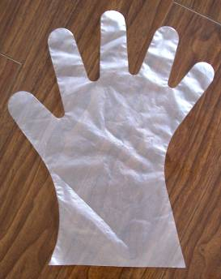
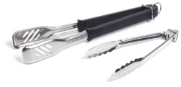
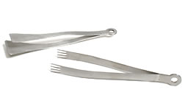
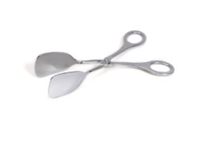
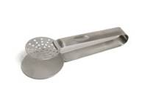

There is a Tool for Every Job!

Slide 3
MISSION
Provide alternative best practices and tools to avoid bare hand contact
Purpose: identify alternative ways to handling food with bare hand contact and address right and wrong ways in handling utensils
Audience: developed for use by industry and regulatory as a training and teaching tool
Document: reflects industry's best practices regarding bare hand contact barriers and will demonstrates alternatives to bare hand contact

Slide 4
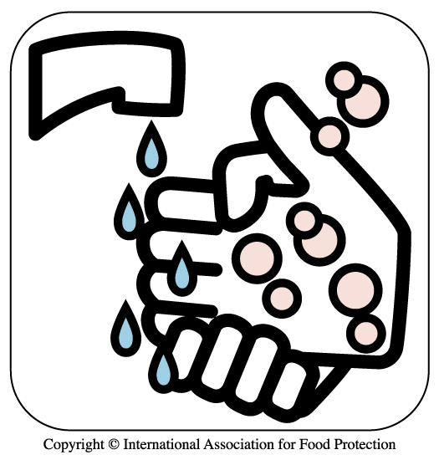
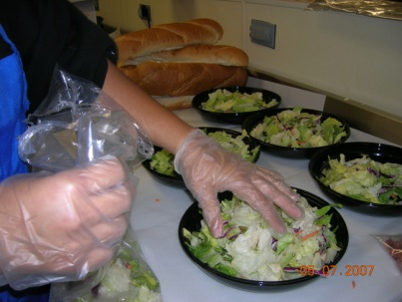
When Should a Food Worker
Choose a Glove Barrier?
The correct use of glove barriers is important during food handling tasks. Single-use gloves can be an effective barrier against the transmission of microorganisms, such as bacteria & viruses, from fingertips or foods
Hand washing is a primary barrier to cross contamination;
barrier utensils & gloves are a secondary barrier
Single-use gloves are defined as a “utensil” in the FDA Food Code
Glove barriers work when handling any ready-to-eat food and another utensil does not provide the hand dexterity for the task (example: slicing carrots or celery). One glove may work on one hand with a utensil used by the other hand

Slide 5
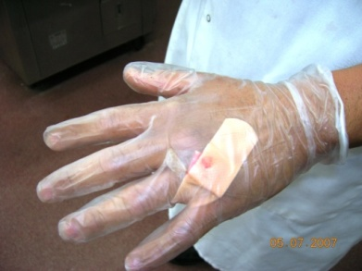
When Should a Food Worker
Choose a Glove Barrier?
Gloves must be worn:
  If you have a bandage, infection, cut, or sore on hands or arms
  When food workers wear artificial nails or fingernail polish they must wear disposable gloves when handling food
Glove use is optional to handle raw meats, but can be used for preparation tasks such as breading/battering meats, poultry, seafood, or vegetables

Slide 6
Glove Barriers Must Be Task-Specific
Use gloves for designated food task only. Disposable gloves are task-specific and should never be worn continuously
Gloves designated for food use should not be used for non-food tasks, such as taking out the garbage, handling money, cleaning surfaces, etc.
Use vinyl, nitrile synthetic, or latex gloves when handling foods near a heat source cooking area, rather than poly (polyethylene) gloves, which are not resistant to heat

Slide 7
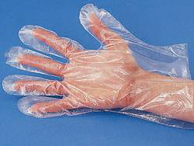
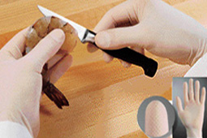

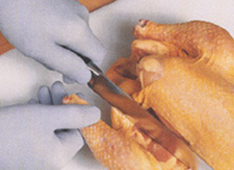
4 Most Common Materials Used
for Food Contact Gloves
Poly gloves
Latex gloves
Vinyl gloves
Nitrile gloves

Slide 8
Avoid Cross-contamination by
Washing Hands & Changing Gloves
If you handle raw meats, poultry, or seafood with gloves on, do not touch ready-to-eat or cooked foods without washing hands and changing gloves
Remove or change gloves when you change activity (for example: making sandwiches or handling money) or whenever you leave your workstation; wash hands before putting on gloves
Consider using task-specific colored gloves for cross contamination prevention

Slide 9
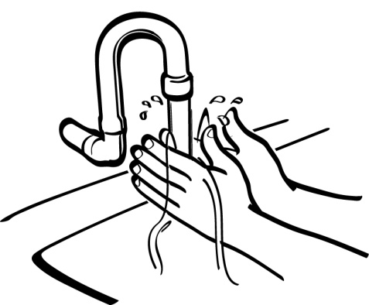
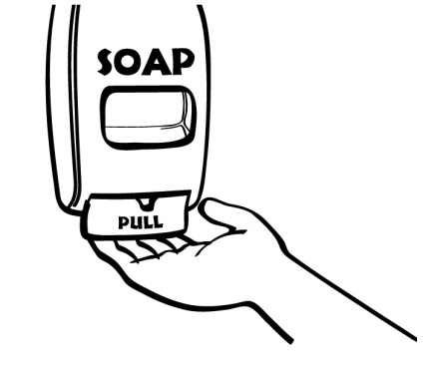
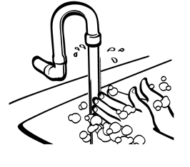
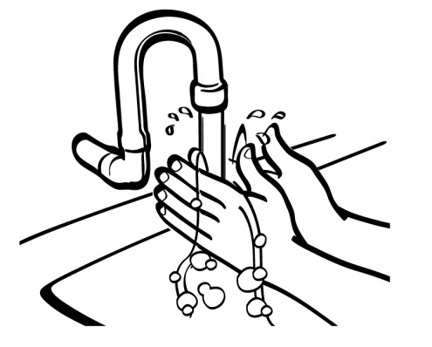
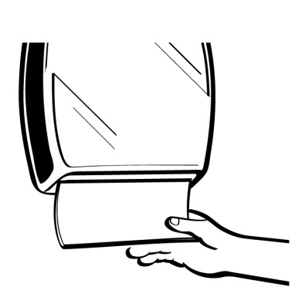
Hand washing
Always wash your hands before putting on a new pair of gloves.
Follow these five steps to wash your hands properly:
1
2
100°F (38°C)
Wet your hands with running water as hot as you can comfortably stand (at least 100°F (38°C)
Apply Soap
3
4
5
Vigorously scrub hands and arms for 10 to 15 seconds. Clean under fingernails and between fingers.
Dry hands and arms with a single-use paper towel or warm-air hand dryer or a hand drying device that uses high velocity pressurized air
Rinse thoroughly under running water

Slide 10
Glove Change Frequency
Change gloves periodically and wash hands each time before & after gloving
After hand washing, dry hands properly and thoroughly before donning gloves to make them easier to slip on
Base the frequency of glove changing on TASK changes
– remove gloves if doing different task not handling ready-to-eat foods;
– change gloves to handle a raw food or different raw species (for example: raw chicken or raw beef);
– change gloves to handle another ready-to-eat food that might transfer a flavor or food allergen
Wash hands and re-glove if a glove develops a hole or tear during usage
Change gloves after sneezing, coughing, or touching your hair or face

Slide 11
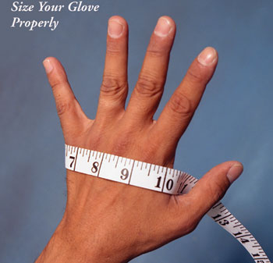
Get the Correct Glove Fit
Glove size is important for safety and comfort
Select the right size for your hand— from small
to extra large
Poly, Vinyl, Latex, & Nitrile usually come in 4 or 5 sizes – Small, Medium, Large, X or XX-Large
Glove sizes are measured across the widest part of the palm as shown

Slide 12
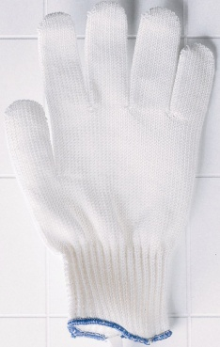
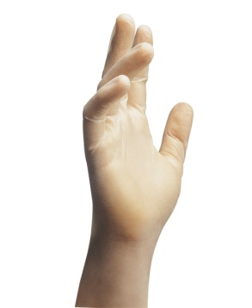
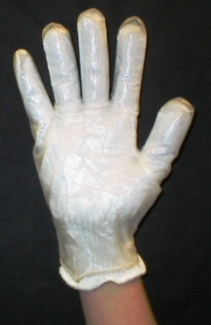
Avoid Cross-contamination with
Cut-resistant Gloves
If wearing a cut-resistant glove to cut or handle raw or ready-to-eat food, wear a larger disposable glove over top to avoid cross-contamination of the reusable cut-resistant glove
Wash, rinse & sanitize the cut-resistant glove between uses
Cut-resistant Safety Glove Needed | + | Disposable Glove Needed | = | Disposable Glove Over Top

Slide 13
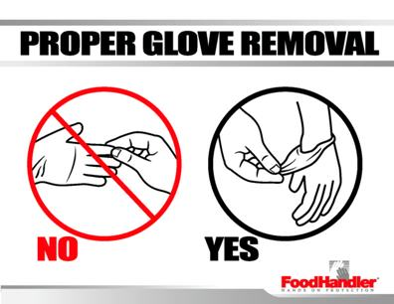
Removing Gloves Correctly
To remove disposable gloves correctly, grasp at the cuff and peel them off inside-out
DO NOT remove and re-use gloves OR re-wash single-use food contact gloves for multiple tasks

Slide 14
Utensils
(scoops, spoons, ladles, spatulas, tongs, forks, chopsticks, toothpicks)
The construction and design of the food contact surface should follow FDA Food Code requirements in section 4-201.11 and be durable and able to retain its characteristic qualities under normal conditions
All utensils should be washed, rinsed, sanitized and air dried between uses and at least every 4 hours when being used.
All in-use utensils shall be changed at least every 4 hours during continual use

Slide 15
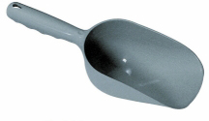
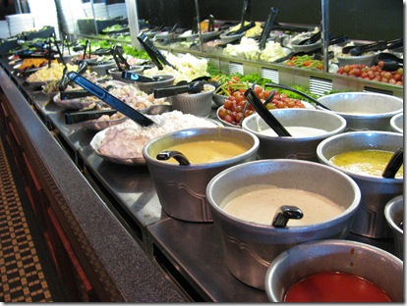
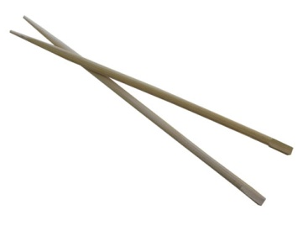
Utensils
(scoops, spoons, ladles, spatulas, tongs, forks, chopsticks, toothpicks)
When not in use, utensils must be stored in a manner to prevent bacterial growth such as in the food, in a clean and protected environment, under running water, or in a container at a minimum temperature of 135°F (57°C)
In-use utensils may not be stored in chemical sanitizer or ice

Slide 16
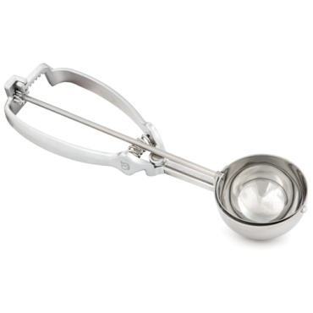
Scoops
Scoops are used by food preparers, servers and customers when preparing, portioning or serving liquid or solid food
Scoops can be used with or without the use of other barriers
When using a scoop with a release trigger, prevent the release trigger from touching the food. This prevents pathogens from the hand transferring to the food

Slide 17
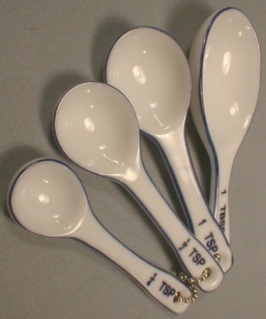
Spoons
Spoons typically have no predetermined serving size or shape
Spoons are used by food preparers, servers and customers when preparing, portioning or serving liquid or solid food
When using spoons for tasting, the spoon used for tasting must only be used once. Disposable or single serving utensils can be used for this task
Improper use of tasting spoons can lead to foodborne illness

Slide 18
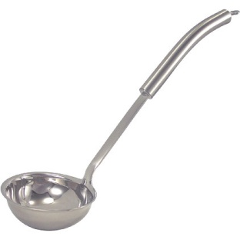
Ladles
Ladles are available in many different sizes and are an ideal utensil for portion control
Ladles are used by food preparers, servers and customers when preparing, portioning or serving liquid or solid food
Ladles can be used with our without the use of other barriers

Slide 19
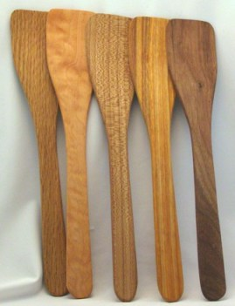
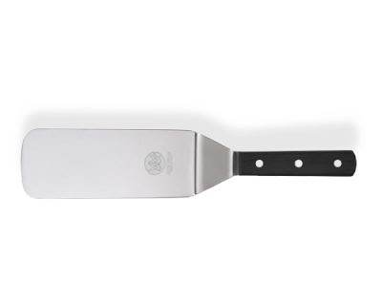
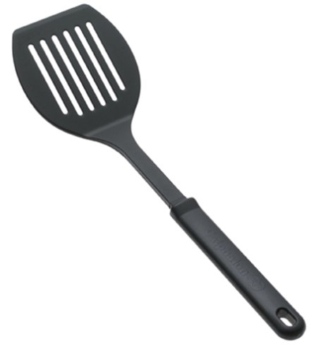
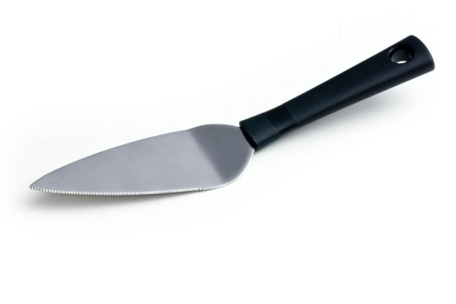
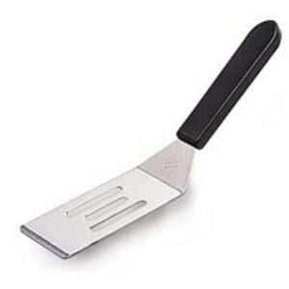
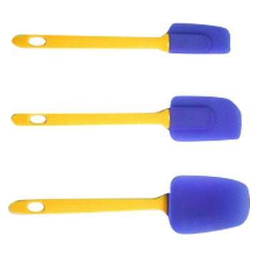
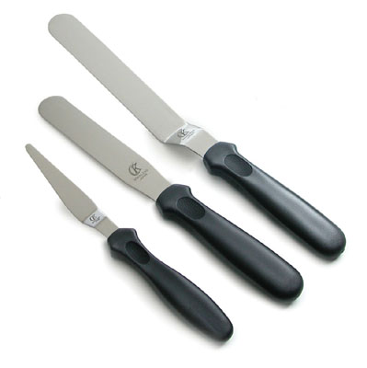
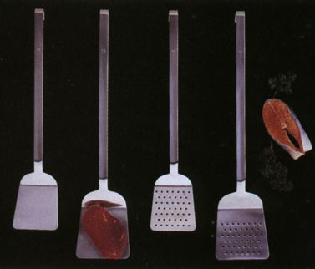
Spatulas

Slide 20
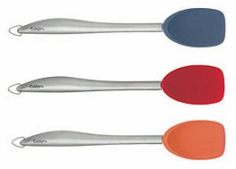
Spatulas
Find a spatula that works best for the task. There are generalized and highly adapted designs widely available
Spatulas are used to stir, scoop, spread or lift food
Spatulas are a practical alternative to handling food with bare hands in many situations

Slide 21
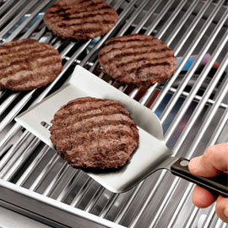
Using Spatulas
Spatulas are used by food preparers and servers when preparing or serving food
Spatulas should be dedicated to a specific task
Wash, rinse, sanitize and air dry spatulas between different tasks
Spatulas may be used as a stand alone tool or in conjunction with another barrier, such as gloves

Slide 22
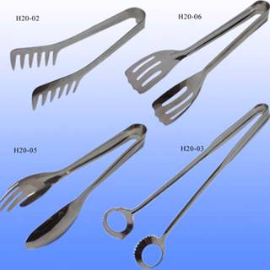
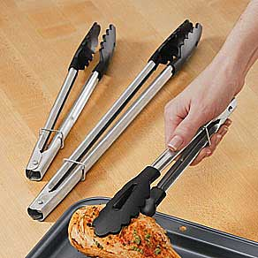
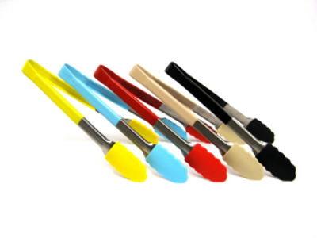
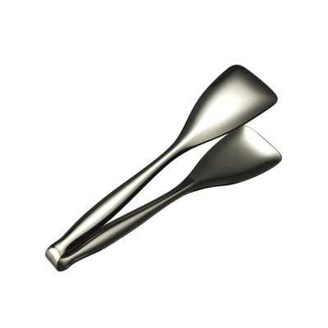
Keeping hands off food
A wide variety of tongs
Tongs
Bread or pastry
Color coded, different sizes, multi-use tongs

Slide 23
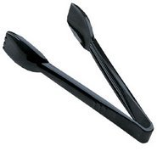
Tongs
Tongs are a practical alternative to handling food with bare hands in many situations
Tongs are a group of kitchen tools that are used to grip or lift food
They are typically used to move a food from one location to another during preparation or service
They can also be used to rotate food during cooking, especially during grilling

Slide 24
Tongs for the Task
Find a tong that works for the task. There are generalized and highly adapted designs widely available. Tongs are a practical alternative to handling food with bare hands in many situations
There are specific designs that are intended to pick up and maneuver sugar cubes, asparagus, shredded cheese, ice, salad, spaghetti, hamburgers, fish bones, melon balls, bagels, cooked crabs, garnishes and tea bags

Slide 25
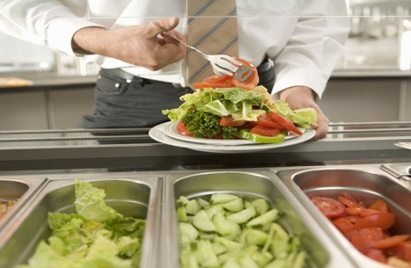
Using Tongs
Tongs should be dedicated to a specific task.
Wash, rinse, sanitize, and air dry all tongs between different tasks
Use the right tong for the job. Tongs can be used as a stand alone tool or in conjunction with another barrier such as gloves

Slide 26
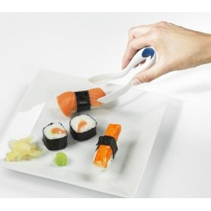
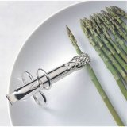
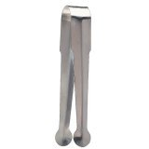
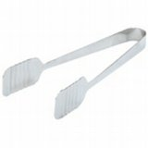
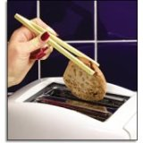
Asparagus tongs
Garnish tongs
Multi-purpose tongs
Sushi tongs
Bagel or toast tongs
Tender touch pastry tongs

Slide 27
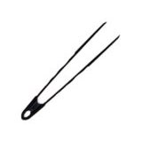
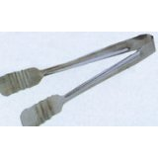





Pastry or meat tongs
High Heat nylon tongs
Fine tip tongs
Spaghetti tongs
Cake tongs
Buffet tongs
Pickle tongs

Slide 28



Forks

Slide 29

Forks
Forks are a practical alternative to handling food with bare hands in many situations
Forks are used to grip or lift food
They are typically used to move food from one location to another or rotate food (while grilling for instance) during preparation
They may also be used during service, such as, to hold or grip a roast on a meat carving station

Slide 30

Using Forks
Forks should be dedicated to a specific task
Wash, rinse, sanitize and air dry forks between different tasks
Forks designed and intended for single-use only must be discarded after each use
Forks may be used as a stand alone tool or in conjunction with another barrier, such as gloves

Slide 31




DELI PAPER

Slide 32

Deli and Bakery Wrap
Deli and Bakery Wrap can be used as a barrier to bare-hand contact
Sheets are single-use and can be used in the foodservice area, by wait-staff, and customers
Sheets can be purchased in a variety of sheet sizes and packages from any restaurant or foodservice supply vendor

Slide 33

Selecting Bakery or Deli Wrap
The main purpose of the wrap is to act as a sanitary barrier between the bare hand and food. Food service operators should select wrap based on intended purpose
Wrap can be dry waxed or without wax. Dry wax will absorb some liquid and prevent the seeping of product liquid onto the hands
Wraps without wax are generally intended to be used for bakery products. Food service operators should select wrap based on intended purpose

Slide 34

Selecting Bakery or Deli Wrap
Operators or purchasing agents must ensure all wrap components are in compliance with the FDA, Title 21, CFR 177.1520
Sheets are manufactured in accordance to Good Manufacturing Practices
Manufacturers of food contact wraps or sheets must demonstrate that all components are safe for use and do not leach components or toxic elements onto the food
Dispensing packages should be well made to prevent contamination of the sheets from external debris and permit easy access to the sheet

Slide 35
Deli and Bakery Wrap Benefits
Dispensing container protects the sheets from contamination before use
Easy to use for foodservice employees and customers
Helps keep food fresh
Absorbs grease and oil while acting as a barrier for food

Slide 36

Using Deli and Bakery Wrap
Sheets should be dispensed one at a time without tearing or contaminating the remaining sheets
If sheets are used as the primary barrier, food preparers should discard used sheets immediately after use. Sheets should not be reused or remain with the food
Store the dispensing container in a location so as to prevent cross contamination from other food or debris

Slide 37




Chopsticks

Slide 38


Chopsticks
Chopsticks may be an alternative to handling food with bare hands
They are typically or most commonly used for eating but may be used to move food from one location to another during preparation or service

Slide 39

Using Chopsticks
Chopsticks should be task specific
Chopsticks may be constructed of a variety of woods, plastics or metals
Chopsticks constructed to be a multi-use item must be washed, rinsed, sanitized, and air dried between different tasks
Chopsticks designed and intended for single-use only must be discarded after each use
Chopsticks are generally used as a stand alone tool/barrier, but may be used in conjunction with another barrier

Slide 40




Toothpicks

Slide 41

Toothpicks
Toothpicks are typically used to prevent bare hand contact with ready-to-eat foods such as hors d’oeuvres, but are also used to hold stacked/layered sandwiches or other items together and/or upright
Toothpicks should be placed in food, by staff, prior to service or presented/provided to consumer in a manner that will prevent possible contamination of the food contact portion of the toothpick, such as, upright in a small/slender glass or container
Toothpicks may be constructed of a variety of woods, plastics or metals. In almost all cases, toothpicks are designed to be single-use items only, discarded after use
If designed to be multi-use, toothpicks must be washed, rinsed, sanitized, and air dried between tasks

Slide 42



QUESTIONS
FCUBU

